Slide 1




U
N
O
J
H
R
G
E
F
L
T
s
A digital library
Make reading accessible to everyone, everywhere.
EBOOKS – AUDIOBOOKS – PEDAGOGICAL CONTENT
Y
i

Slide 2

READ, EVERYWHERE
+1M CONTENTS
EBOOKS
AUDIOBOOKS
COMICS
NEWSPAPERS
DOCUMENTS
PODCASTS
YouScribe is the largest streaming digital library, offering access to more than 1.2 million titles
Digital reading provides wider and easier access to reading and meets the expectations of all types of readers: entertainment, education…
Especially in countries where the traditional distribution channels are obstructed.
Reading even without internet connection, thanks to the offline mode on the YouScribe mobile application
A website and App translated into three languages (Arabic, English, French).
Content is available in many languages, among which also national and African local languages.
2

Slide 3
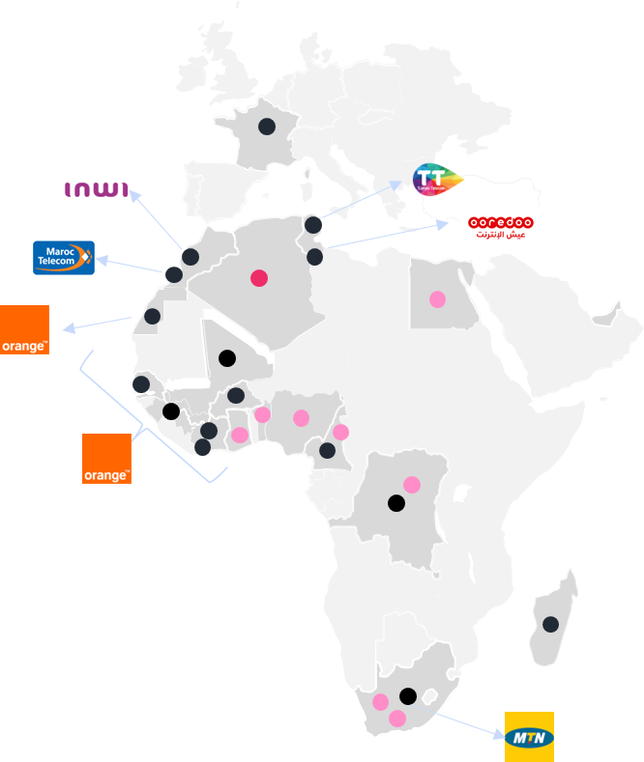
OUR SUCESS STORY IN LESS THAN TWO YEARS
Launchings
Launched service
Being launched
Our service uses a microbilling solution provided by telecom operators, a payment method allowing a wider access to the library and adapted to Africa.
2023 Roadmap

Slide 4

An offer that grows with the readers
A permanent enrichment of of the all-in-one offer (ebooks, audiobooks, newspapers …)
  Accompanies YouScribe’s readers usage, with a clear progression of audiobooks in the last 2 years.
  A wide range of publishers : Macmillan, Springer, Jonathan Ball, Harper Collins …
A news booth that improves every month ; daily news, local information …
Creation of a community of ‘YouScribers’ who can share their comments on the library (based on the strength of peer-to-peer).
Thanks to an added AI software, YouScribe proposes tailored recommendations to readers, depending on their profiles and taste. This allows us to boost usage, and retention.
*Source : 2022 survey on printed books, digital and audio usage, SOFIA/SNE/SGDL

Slide 5

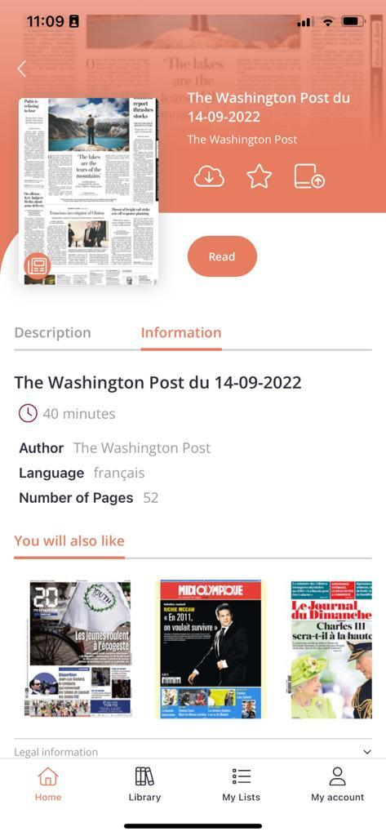



Our App: designed to offer the best User Experience
“
« Smartphones are the predominant support for audiobooks consumption, and are way ahead of other devices even for ebook reading. »*
Our application has been crafted to fit the habits of ebooks readers. Entirely rebuilt in 2022 (UX/UI/tech), our app is even more modern, fluid and aesthetic.
A premium service and modern features to strenghten the reading experience (new titles notifications, highlighting, integrated dictionary, voice over …)
An overall goal to create a smooth universe between App and mobile.
The ‘Publish’ function, which allows users to contribute to the enrichment of the catalogue: giving voice to tomorrow’s pens.
Available on
Available on
*Source : 2022 survey on printed books, digital and audio usage, SOFIA/SNE/SGDL

Slide 6
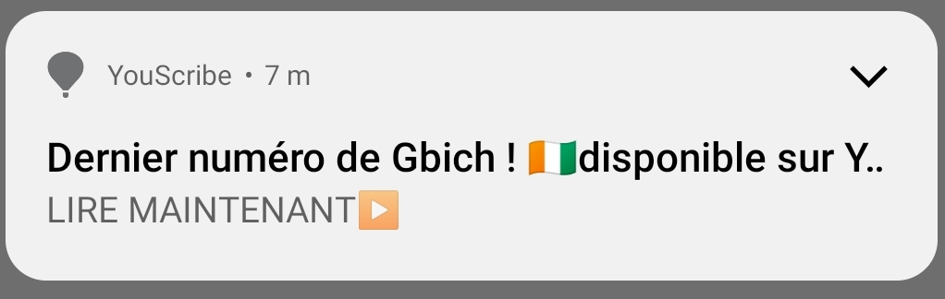







PROMOTION
CHANNELS
Push application sent to our Ivory Coast subscribers base
Push application sent to our France subscribers base
Monthly highlights for our readers
  Depending on local news and that of the YouScribe community
  Depending on relevant new integrations to the catalogue
Special efforts in terms of user-friendliness and retention :
  Personalized recommendations
  SMS and push app notifications
  Social media promotion
Tailored support and day-to-day communication from YouScribe’s team members
  Integration of new titles (on average 230 per day in 2022), and sourcing of new content on request
Monthly promotional banner on our website and application
Promotional calendar for April 2023
Monday | Tuesday | Wednesday | Thursday | Friday
3 | 4 | 5 | 6 | 7
10 | 11 | 12 | 13 | 14

Slide 7


A peek into YouScribe’s content

Slide 8

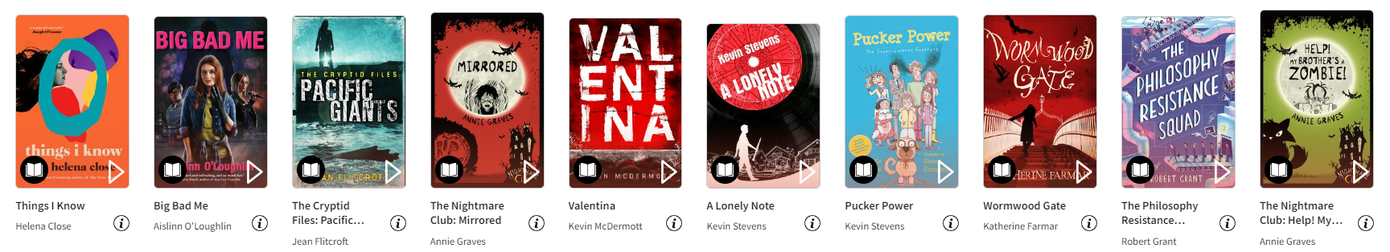



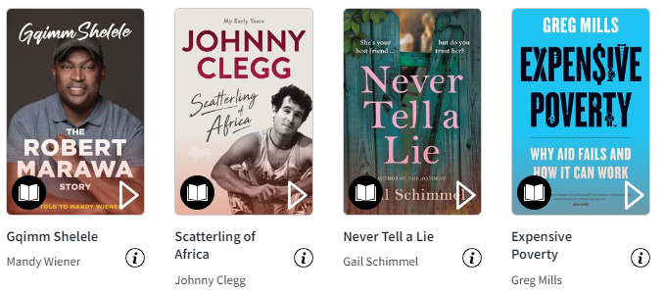
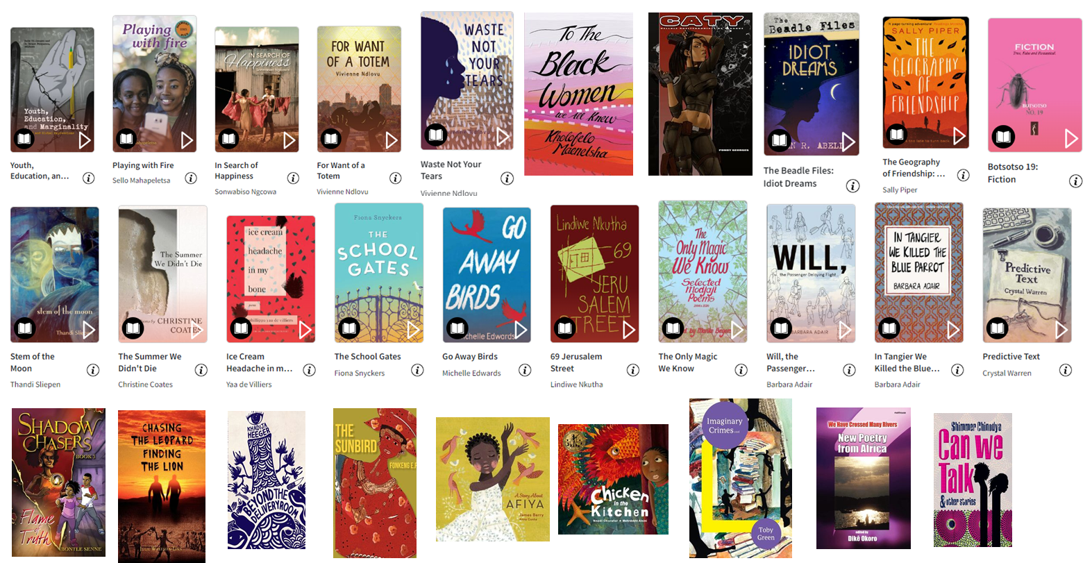

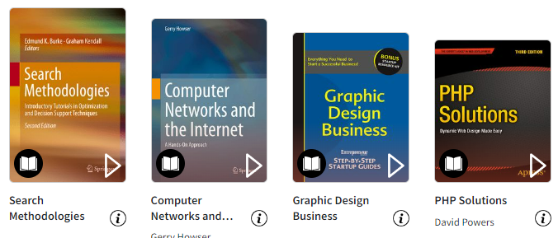
MILLION OF TITLES TO CHOOSE FROM

Slide 9





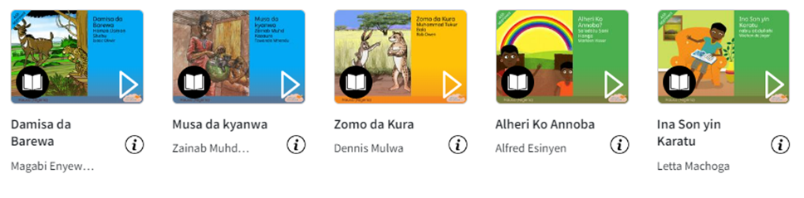
Our local languages offer : iziZulu, iziXhosa, Igbo, Swahili, and more

Slide 10
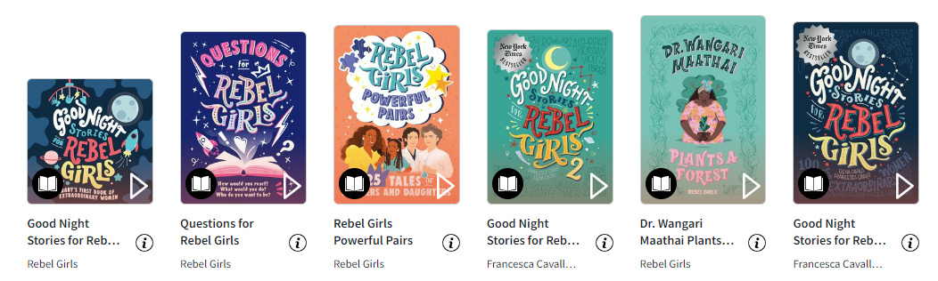
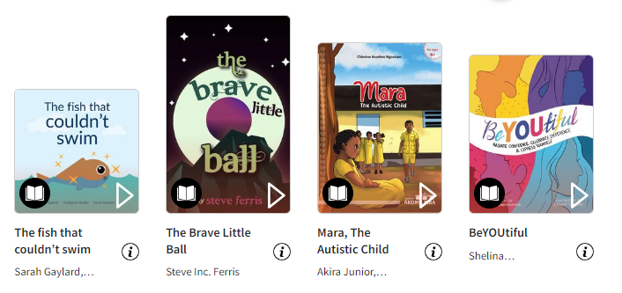

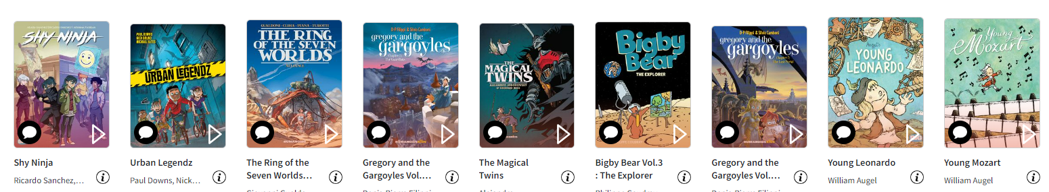
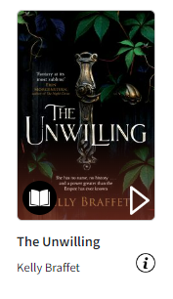
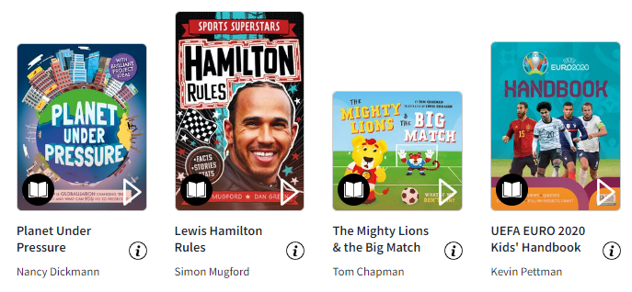

International titles and comics
Arriving
mid-2023

Slide 11







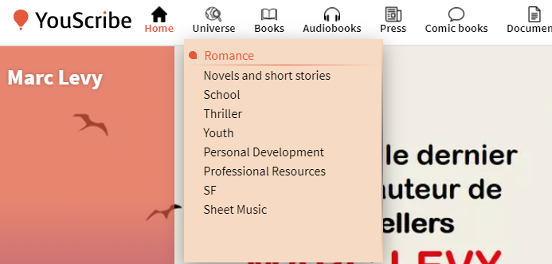
A CATALOGUE ACCESSIBLE BY UNIVERSES
YouScribe's approach is to satisfy readers by areas of interest
5 CATEGORIES
29 THEMES
123 SUB THEMES
Books
+ 200,000 references including exclusivities
Press & Magazines
+ 200 different titles and magazines
Comics
+ 3,800 titles from the biggest publishing brands (Dupuis, Lombard, Humano Associés)
Audiobooks
More than 25,000 references including all new bestsellers
Documents & Scores
+ 800,000 educational documents published by students, teachers, amateurs, etc
+ 120,000 music scores
LEISURE
SF & Fantasy
11
SCIENCE
Professional resources
EDUCATION
Etc.
Romance
YOUTH
+120 SUB THEMES
SPORT & LEISURE
All our universe at your fingertips
ART, MUSIC
Etc.

Slide 12


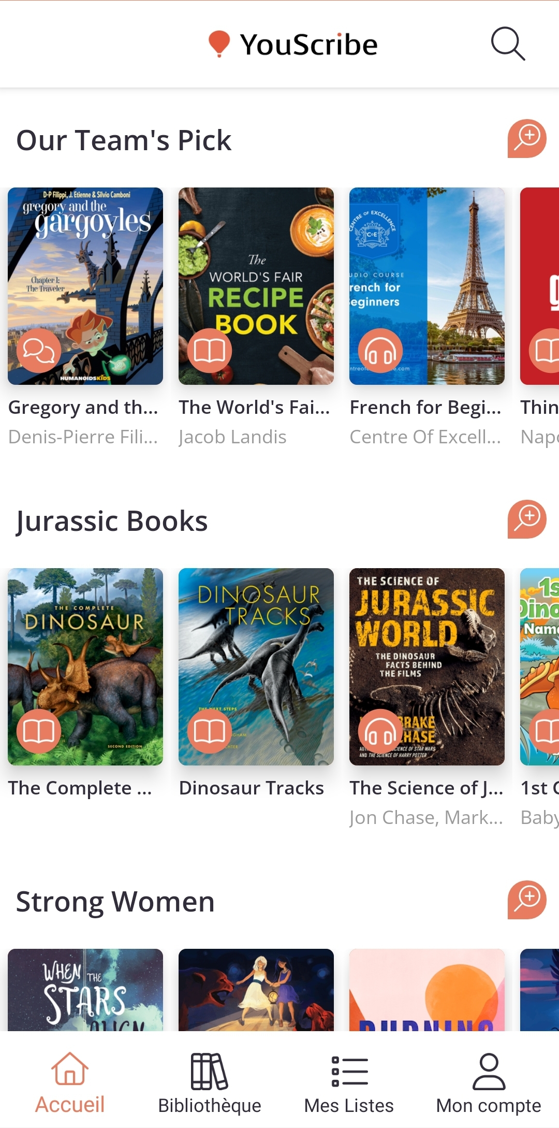



THE GOOD FIT FOR EVERY READER
YouScribe works with 2,000 publishers from Africa and the world, integrating more than 200 new titles everyday in 15 African languages
A dedicated team strives to enliven the gems of the catalogue and make sure every reader finds a fitting read
Strong editorialization to follow each country’s calendar of events and taste in literature
Our million subscribers can enjoy titles like :
  The Washington Post, updated every day
  Born a Crime by Trevor Noah, provided to us by PanMacmillan South Africa
  More than 25,000 audiobooks depending on their need of the day : leisure, education, business, self-help ….
Our most read titles
in Africa in 2022

Slide 13

































Publishers who trust us with their content

Slide 14












USER EXPERIENCE
With its broad catalogue, YouScribe catters to the individual needs of a wide variety of users all over the world
MARIAM 40 years-old, HR relations (Yaoundé)
ADAMA 35 years-old, Banking executive (Abidjan)
FATOU 20 years-old, Student (Dakar)
‘’Active mum and avid reader of novels, I can listen to audiobooks on my weekly commute thanks to YouScribe and read all week-end on my tablet! All it takes is one click!’’
‘‘My work field is constantly changing, both in practice and regulations. Having access to a wide range of professional development books allows me to quickly find quality answers to all the questions I ask myself.’’
‘’As a young Law student, books are often expensive and hard to find for me. Having all my textbooks and novels accessible on my phone is easier to carry and more convenient!’’
Maryam’s reading list
Adama’s reading list
Fatou’s reading list
14

Slide 15

Ready to embark on the adventure?
A3W6NI3X-65565
YIT66JKD-65565
J3ZZY16X-65565
LU8J22RR-65565
DACV0JNU-65565
3EWLAARK-65565
JIN57WVT-65565
DBSND3FG-65565
D52NBGCB-65565
DSA5E5I0-65565
Your YouScribe demo account
ID : WASPIES_DEMO
Password : waspiesYS23
The account can be used here : YouScribe Log In

Slide 16




















DISTINCTIONS
CONTACTS
Anne-Sophie Steinlein
COO
13 rue du Mail, 75002 PARIS
anne-sophie.steinlein@youscribe.com
Tel : + 33 6 88 99 62 75
Clara Ferrari
Publishers Relationship Manager
13 rue du Mail, 75002 PARIS
clara.ferrari@youscribe.com
Tel : + 33 6 25 44 42 31
YouScribe works with the sponsorship of the French National Commission for the UNESCO, as part of the “reading for all program”.
In March 2018, YouScribe signed
a 3-year long partnership convention with the OIF, aiming to promote reading and learning of the French language all around the world.
What they have to say
Click on the logos to access the content
English
16

